Slide 1
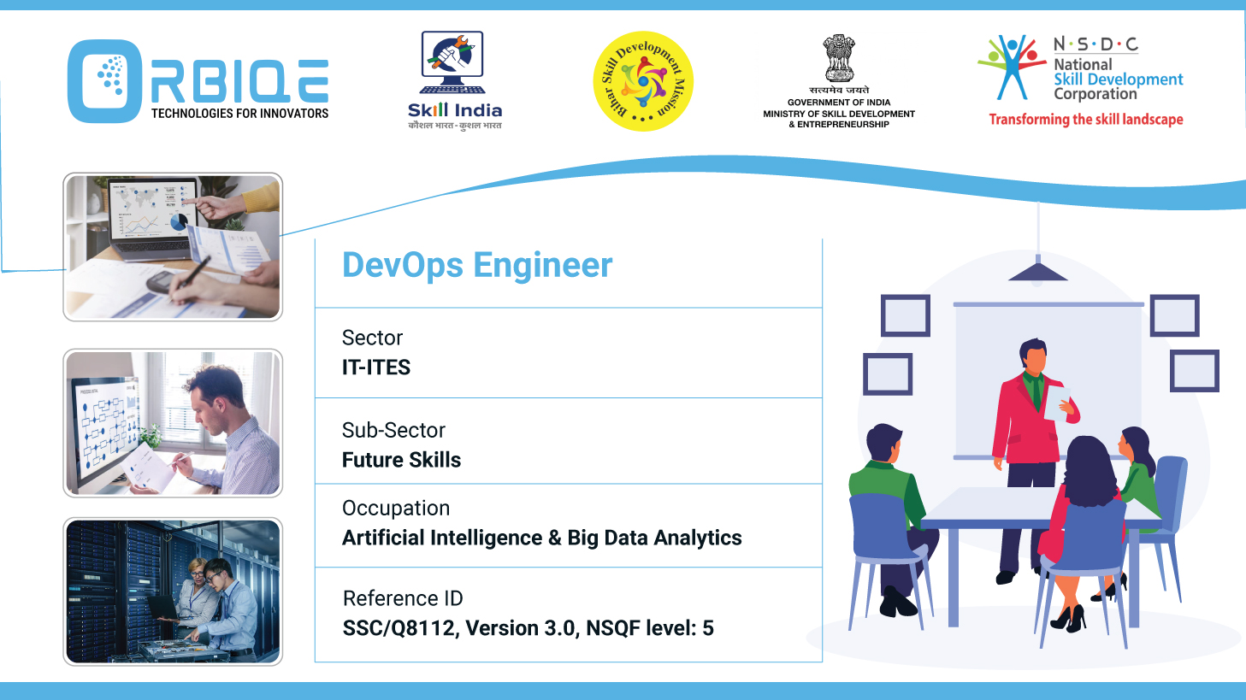
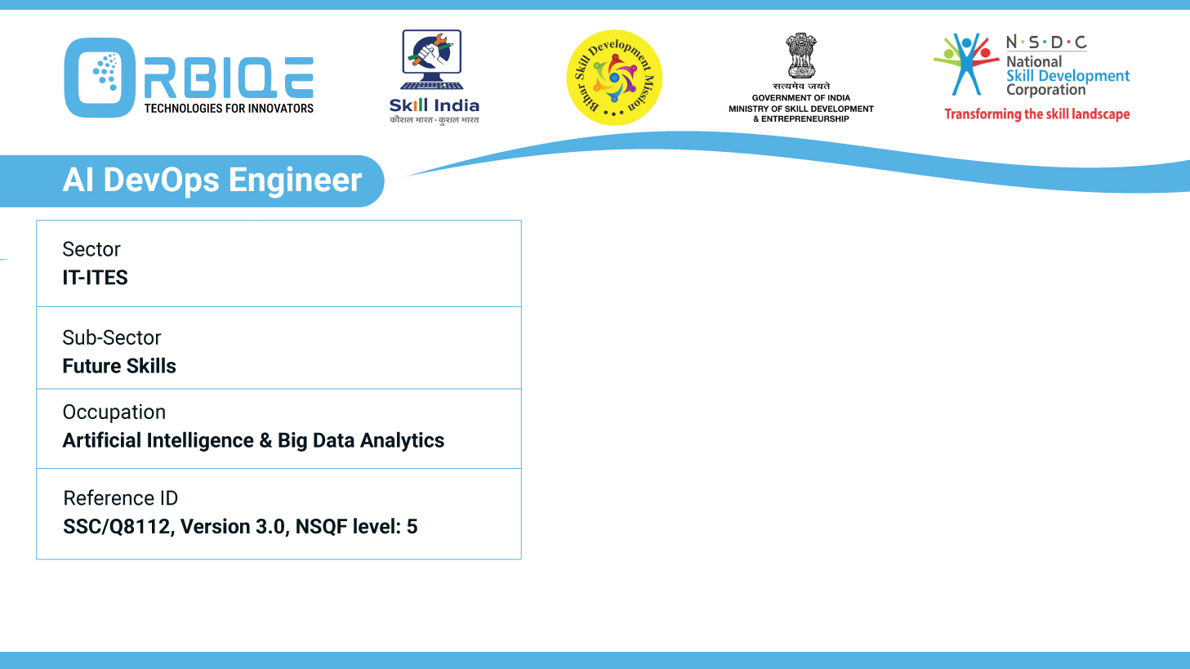
Name- Krishna Kant Dubey

Slide 2

Security and Compliance

Slide 3
Agenda
Implement security measures
Automate security checks

Slide 4
Implement security measures
Code scanning
Vulnerability assessments
Access controls to protect against threats
Ensure compliance with regulations

Slide 5
Code scanning

Slide 6
Vulnerability assessments

Slide 7
Access controls to protect against threats

Slide 8
Ensure compliance with regulations

Slide 9
Thank You

